Slide 1
Introduction to Data Structures
The Redo button will reverse the last use of the Undo button, restoring the previous action.
The Ctrl-Y keyboard shortcut also can be used in place of the Redo button.

Slide 2
Data Types & Data Structures
Applications/programs read data, store data temporarily, process it and finally output results.
What is data? Numbers, Characters, etc.
Data
Application/ Program
Data

Slide 3
Data Types & Data Structures
Data is classified into data types. e.g. char, float, int, etc.
A data type is (i) a domain of allowed values and (ii) a set of operations on these values.
Compiler signals an error if wrong operation is performed on data of a certain type. For example, char x,y,z; z = x*y is not allowed.

Slide 4
Data Types & Data Structures
Examples
Data Type | Domain | Operations
boolean | 0,1 | and, or, =, etc.
char | ASCII | =, >, <, etc.
int | -maxint to +maxint | +, -, =, ==, >, <, *, /, etc.

Slide 5
Data Types & Data Structures
int i,j;→ i, j can take only integer values and only integer operations can be carried out on i, j.
Built-in types: defined within the language e.g. int,float, etc.
User-defined types: defined and implemented by the user e.g. using typedef or class.

Slide 6
Data Types & Data Structures
Simple Data types: also known as atomic data types → have no component parts. E.g. int, char, float, etc.
21
3.14
‘a’

Slide 7
Data Types & Data Structures
Structured Data types: can be broken into component parts. E.g. an object, array, set, file, etc. Example: a student object.
Name
A | H | M | A | D
20
C | S | C
Age
Branch
A Component part

Slide 8
Data Types & Data Structures
A data structure is a data type whose values (i) can be decomposed into a set of component elements each of which is either simple (atomic) or another data structure (ii) include a structure involving the component parts.

Slide 9
Data Types & Data Structure
Possible Structures: Set, Linear, Tree, Graph.
LINEAR
SET
TREE
GRAPH

Slide 10
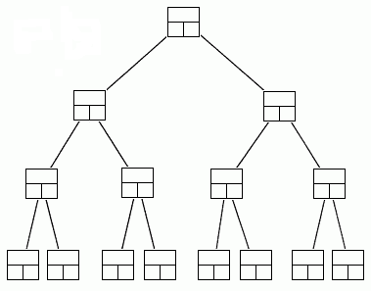
Data Structures
A data structure is a scheme for organizing data in the memory of a computer.
Some of the more commonly used data structures include lists, arrays, stacks, queues, heaps, trees, and graphs.
Binary Tree

Slide 11
Data Structures
The way in which the data is organized affects the performance of a program for different tasks.
Computer programmers decide which data structures to use based on the nature of the data and the processes that need to be performed on that data.

Slide 12
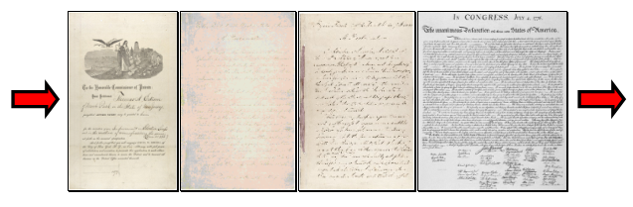
Example: A Queue
A queue is an example of commonly used simple data structure. A queue has beginning and end, called the front and back of the queue.
Data enters the queue at one end and leaves at the other. Because of this, data exits the queue in the same order in which it enters the queue, like people in a checkout line at a supermarket.

Slide 13
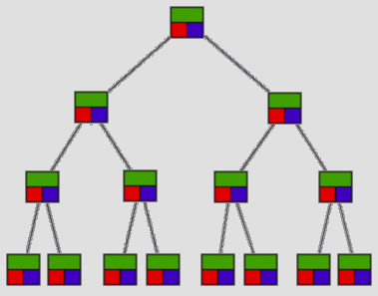
Example: A Binary Tree
A binary tree is another commonly used data structure. It is organized like an upside down tree.
Each spot on the tree, called a node, holds an item of data along with a left pointer and a right pointer.
The pointers are lined up so that the structure forms the upside down tree, with a single node at the top, called the root node, and branches increasing on the left and right as you go down the tree.

Slide 14
Choosing Data Structures
By comparing the queue with the binary tree, you can see how the structure of the data affects what can be done efficiently with the data.

Slide 15
Choosing Data Structures
A queue is a good data structure to use for storing things that need to be kept in order, such as a set of documents waiting to be printed on a network printer.
The jobs will be printed in the order in which they are received.
Most network print servers maintain such a print queue.

Slide 16
Choosing Data Structures
A binary tree is a good data structure to use for searching sorted data.
The middle item from the list is stored in the root node, with lesser items to the left and greater items to the right.
A search begins at the root. The computer either find the data, or moves left or right, depending on the value for which you are searching.
Each move down the tree cuts the remaining data in half.
Items can be located very quickly in a tree.
Telephone directory assistance information is stored in a tree, so that a name and phone number can be found quickly.

Slide 17
Choosing Data Structures
For some applications, a queue is the best data structure to use.
For others, a binary tree is better.
Programmers choose from among many data structures based on how the data will be used by the program.

Slide 18
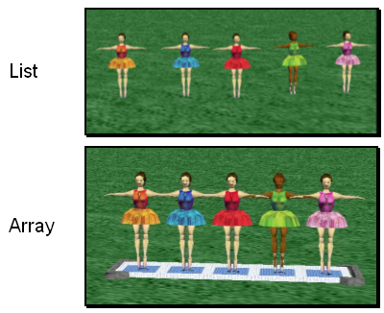
Data Structures
two data structures that can be used to organize data, or to create other data structures:
Lists
Arrays

Slide 19
Lists & Arrays
A list is an ordered set of data. It is often used to store objects that are to be processed sequentially.
A list can be used to create a queue.
An array is an indexed set of variables, such as dancer_{[1]}, dancer_{[2]}, dancer_{[3]},… It is like a set of boxes that hold things
A list is a set of items.
An array is a set of variables that each store an item.

Slide 20
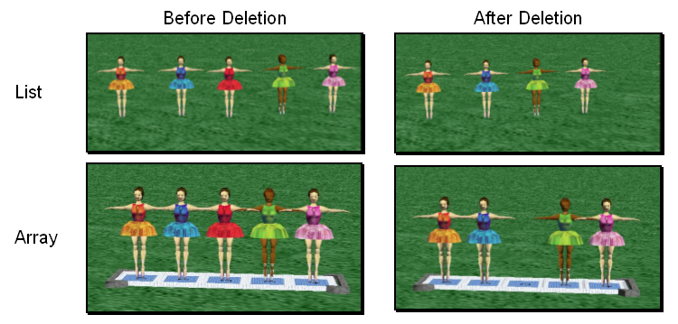
Arrays and Lists
You can see the difference between arrays and lists when you delete items.
In a list, the missing spot is filled in when something is deleted. In an array, an empty variable is left behind when something is deleted.

